Slide 1
HR Analytics Dashboard
CREATED BY: Karthik N
DATE: 23 June 2026

Slide 2
Project Objective
To analyze employee attrition patterns and identify the key factors contributing to employee turnover using SQL, PostgreSQL, and Power BI.
Business Problem
Employee attrition can lead to increased hiring costs, productivity loss, and disruption of business operations. HR leaders need actionable insights to identify high-risk employee groups and implement targeted retention strategies.
Project Scope
Data Audit & Quality Assessment
Data Cleaning & Transformation
Data Warehouse Design
Star Schema Modeling
Exploratory Data Analysis (EDA)
KPI Development
Interactive Power BI Dashboard
Executive Insights & Recommendations
Tools Used
PostgreSQL
DBeaver
VS Code
SQL
Power BI
Git & GitHub
Dataset Summary
Total Employees: 1,470
Total Columns: 35
Employee Attrition Dataset
HR Domain Analytics

Slide 3
Business Problem & Key Questions
Problem Statement
The organization is experiencing employee attrition and wants to understand:
Who is leaving?
Why are employees leaving?
Which employee segments are at highest risk?
What actions can reduce attrition?
Key Business Questions
What is the overall employee attrition rate?
Which departments experience the highest attrition?
Which job roles experience the highest attrition?
Does overtime increase employee turnover?
Which age groups are most likely to leave?
How does compensation influence attrition?
Does job satisfaction impact employee retention?
Does work-life balance influence employee turnover?
Are new employees more likely to leave than experienced employees?
What employee profile represents the highest attrition risk?
Expected Outcome
Identify the major drivers of attrition and provide actionable recommendations to improve employee retention.

Slide 4
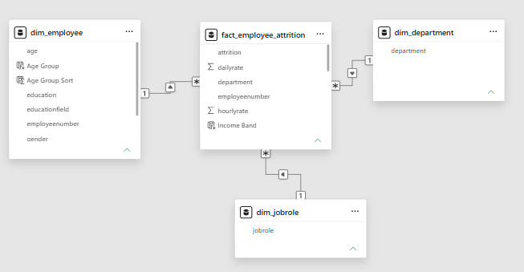
Data Model & Architecture
STAR Schema Design
ER Diagram
Dimension Tables
dim_employee
Employee Number (PK)
Age
Gender
Marital Status
Education
Education Field
Job Level
dim_department
Department (PK)
dim_jobrole
Job Role (PK)
Fact Table
fact_employee_attrition
Employee Number (FK)
Department (FK)
Job Role (FK)
Attrition
Overtime
Monthly Income
Job Satisfaction
Work-Life Balance
Years at Company
Years in Current Role
Years Since Last Promotion
Years with Current Manager
Training Times Last Year

Slide 5
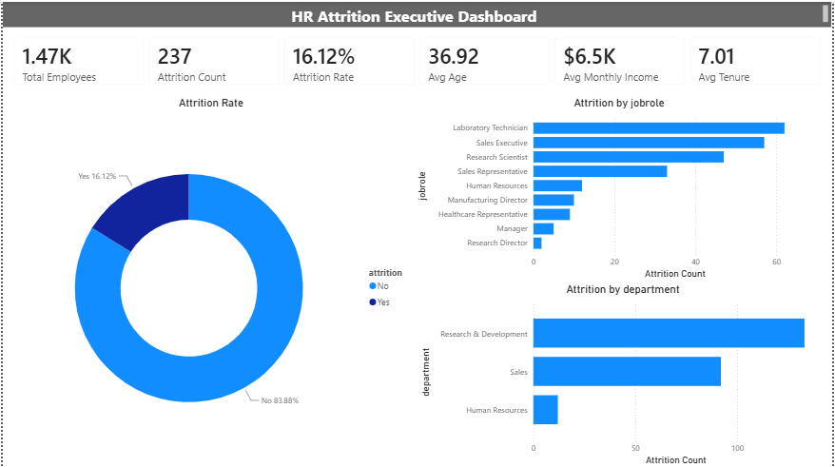

Slide 6
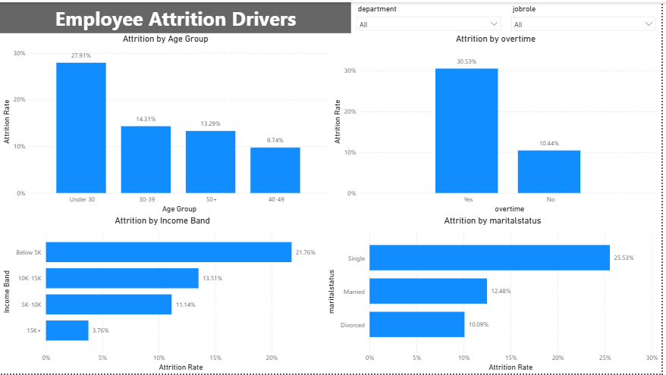

Slide 7
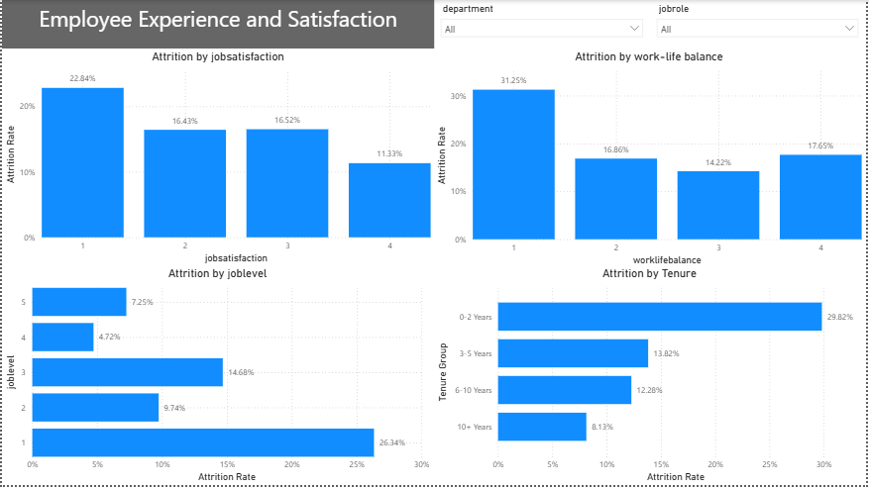

Slide 8
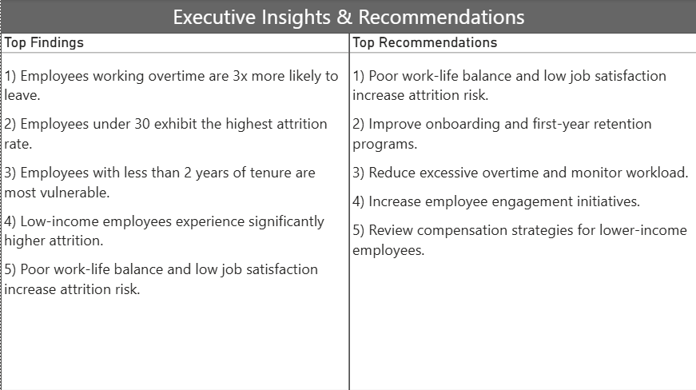

Slide 9
Conclusion - Business Value
The dashboard enables HR leaders to:
Identify high-risk employee groups
Monitor workforce attrition trends
Improve employee retention strategies
Support data-driven workforce planning
Reduce replacement and hiring costs

